Slide 1

TITLE : Uncovering Sleep and Lifestyle Patterns for Stress Management and Better Health
Global Academy of Technology
Department of Artificial Intelligence and Machine Learning
Altair BCC&I Data Science Contest!
Sample Analysis Report on Altair Rapid Miner
TEAM: BYTE CRAFTERS
Team members:
Aishwarya H M
Bindhiya T
S Tanisha

Slide 2
Introduction
Project Objective: The objective of our project is to investigate data analysis techniques, propose a model for uncovering sleep and lifestyle patterns, identify factors contributing to stress, and provide strategies for improved stress management and overall health.
Factors considered: Using diverse Machine learning techniques,Python Libraries like Scikit-learn ,NumPy, pandas and Web Application using Streamlit, LLM(Langchain,cTransformers) and ALTAIR RAPID MINER for Data Visualization and Analysis.

Slide 3
Problem Statement
The modern lifestyle often leads to increased stress levels and disrupted sleep patterns, which negatively impact overall health and well-being. Despite the abundance of data available from various health monitoring devices, there is a lack of comprehensive tools that can effectively analyze this data to provide actionable insights for stress management and sleep improvement. This project aims to address this gap by leveraging advanced technologies to uncover patterns in sleep and lifestyle data, thereby providing personalized recommendations to enhance sleep health and manage stress.
Objectives
1. Integrate sleep and lifestyle data from multiple sources for cohesive analysis.
2. Use Python and ALTAIR RAPID MINER for comprehensive exploratory data analysis.
3. Implement Scikit-Learn for predictive modeling of stress and sleep quality.
4. Generate personalized insights with advanced LLMs like Langchain and Mistral7B.
5. Develop a user-friendly Streamlit application for interactive data visualization and recommendations.

Slide 4
Implementation Details/Dataset Description
1. Implementation Details:
Collect, preprocess, and integrate sleep and lifestyle data from wearables and self-reports.
Perform EDA using Python, Jupyter Notebook, and ALTAIR RAPID MINER, and build predictive models using Scikit-Learn, while generating personalized insights with LLMs.
Develop a Streamlit application for interactive data input, analysis visualization, and recommendations.
2. Dataset Usage:
The Sleep Health and Lifestyle Dataset comprises 400 rows and 13 columns, covering a wide range of variables related to sleep and daily habits. It includes details such as gender, age, occupation, sleep duration, quality of sleep, physical activity level, stress levels, BMI category, blood pressure, heart rate, daily steps, and the presence or absence of sleep disorders.
Kaggle Link:
Sleep Health and Lifestyle Dataset (kaggle.com)

Slide 5
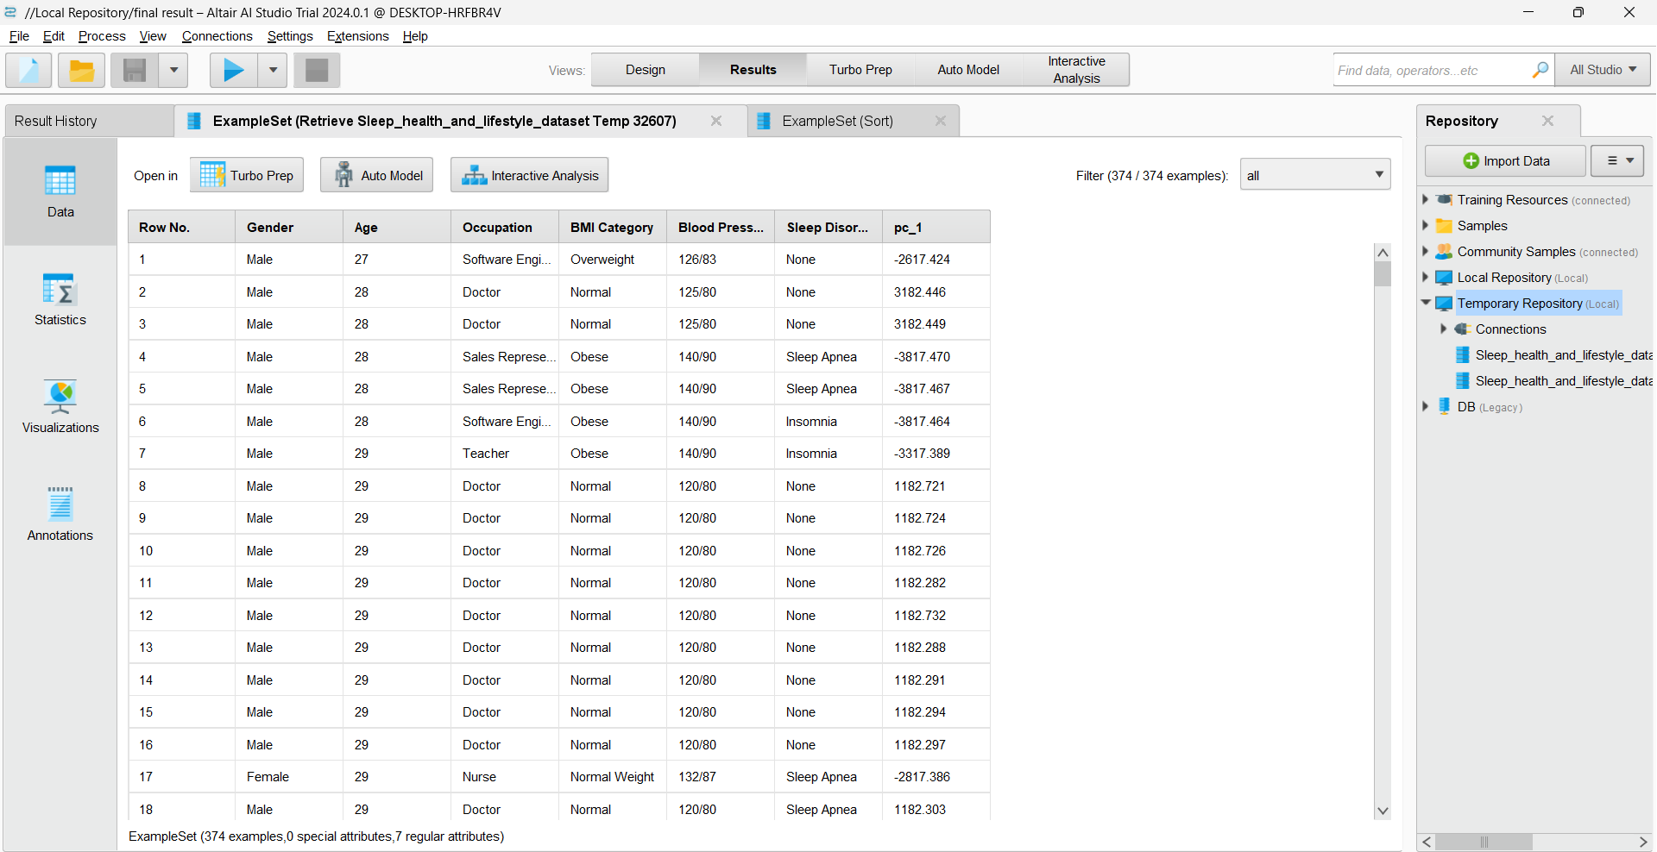
Dataset:

Slide 6
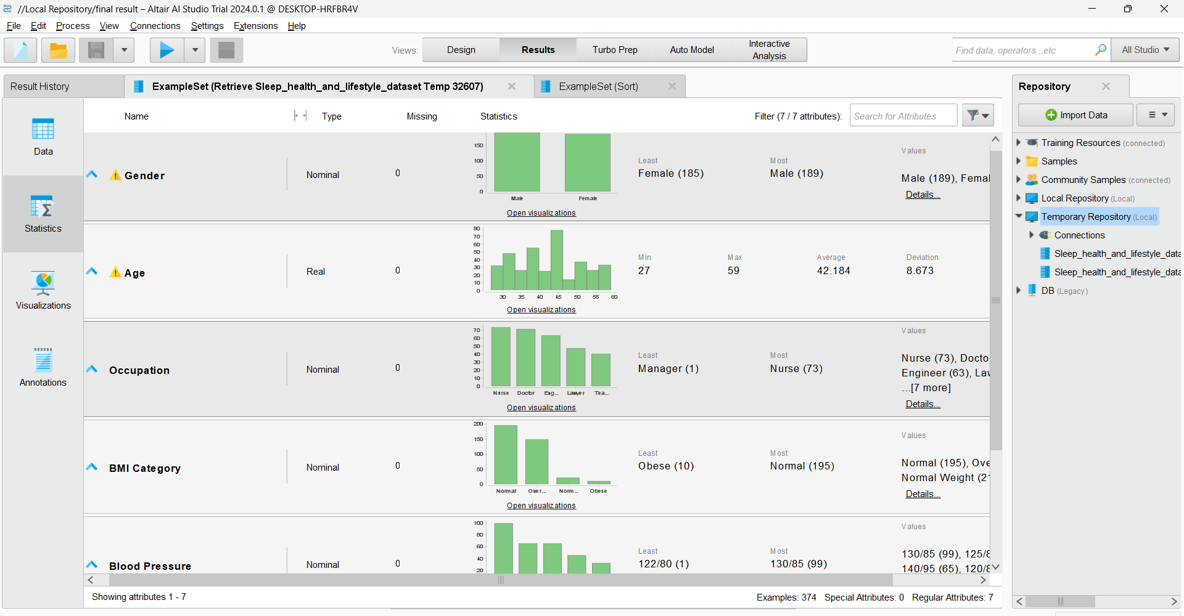
Statistics of Data:

Slide 7
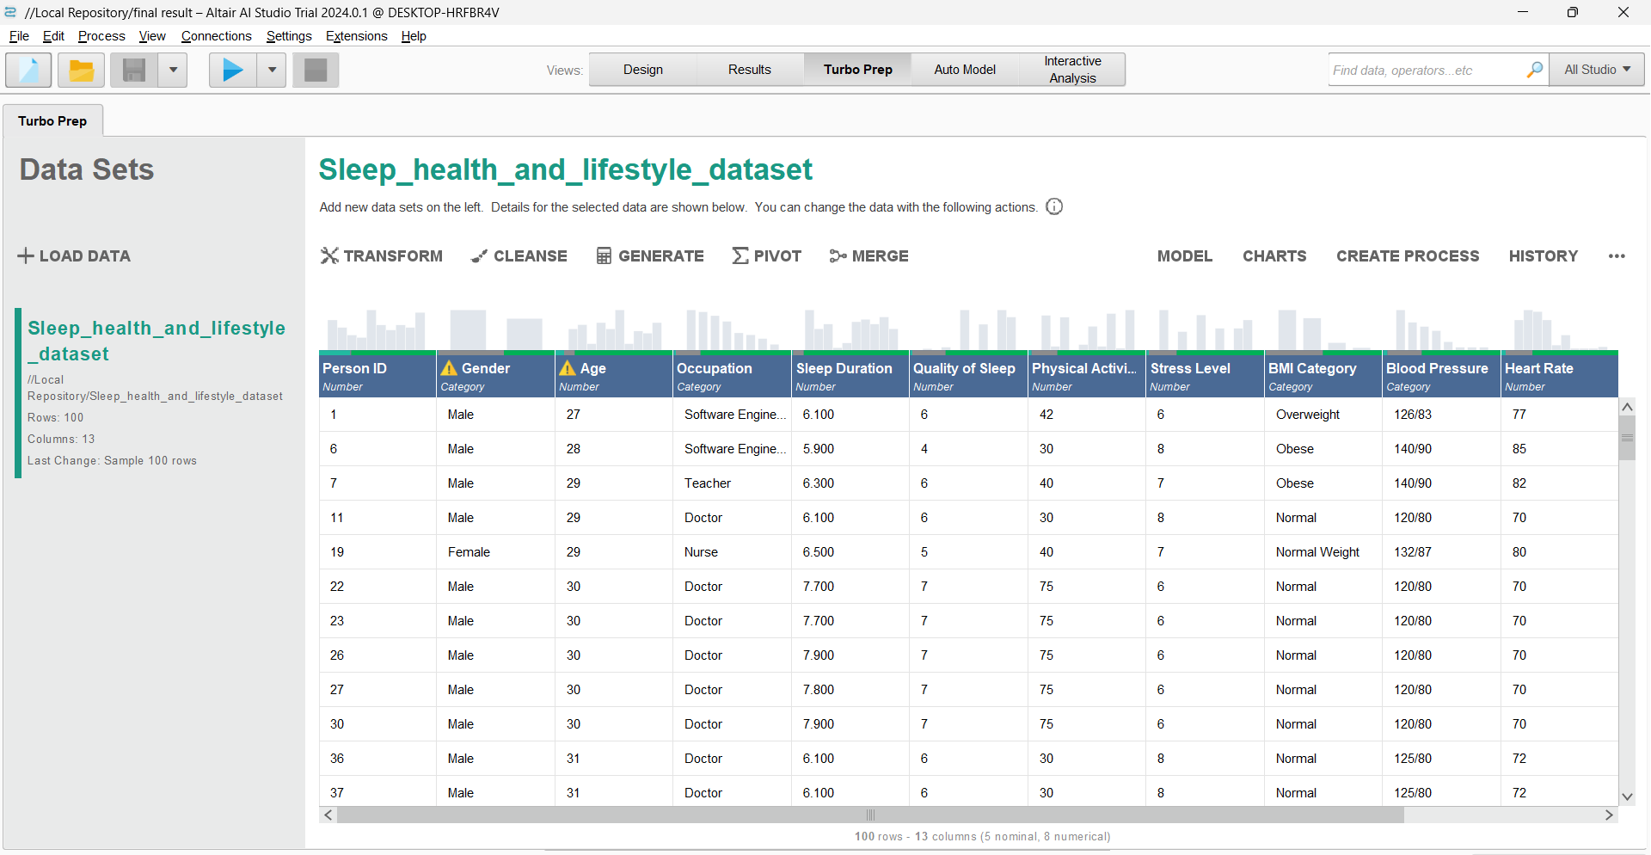
Data Transformation and Cleansing Workflow in RapidMiner: Enhancing Sleep Health and Lifestyle Dataset:

Slide 8
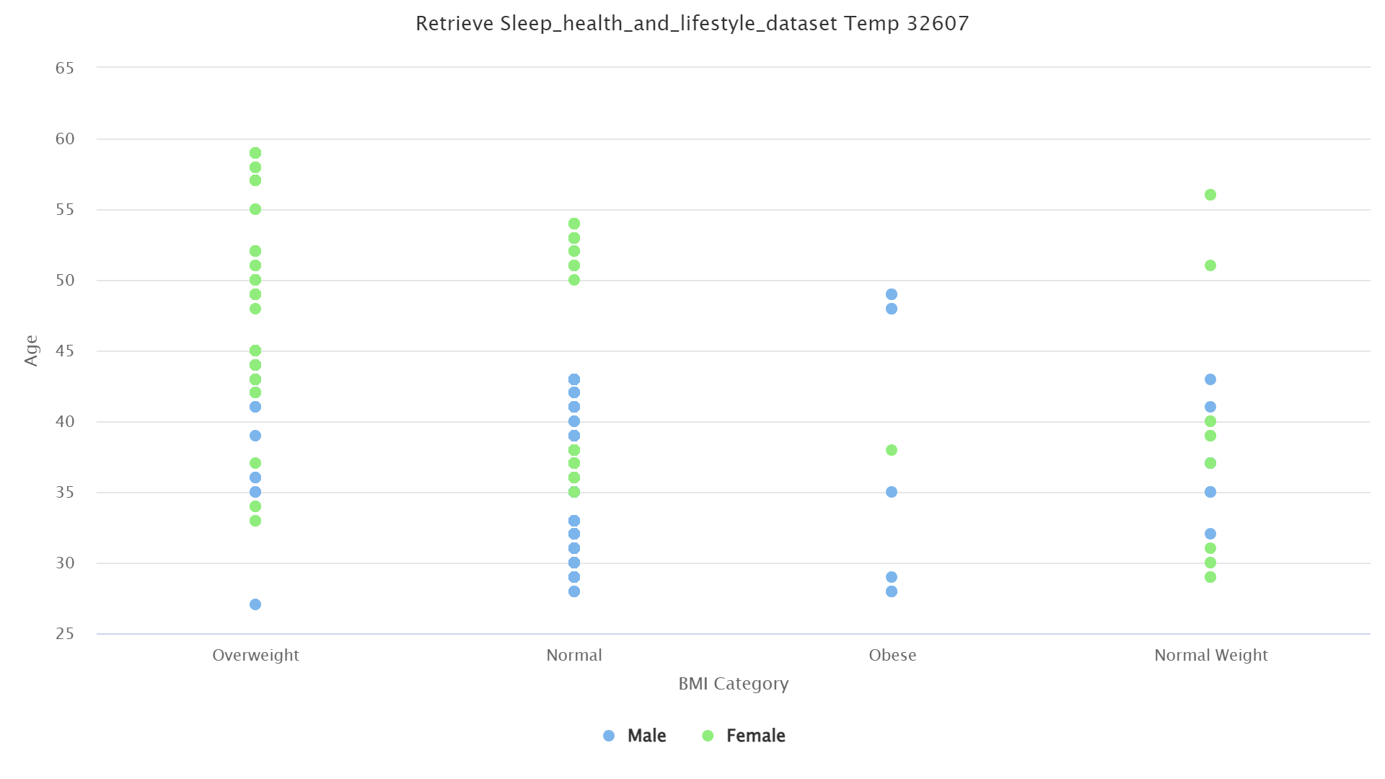
Analysis on the Dataset:
1.The scatter plot shows that most individuals, regardless of BMI category, are between the ages of 35 and 55, with both males and females represented across all BMI categories.
2.Females (green dots) appear more frequently in the overweight and normal BMI categories, while males (blue dots) are more spread out across all BMI categories, including obese and normal weight.

Slide 9
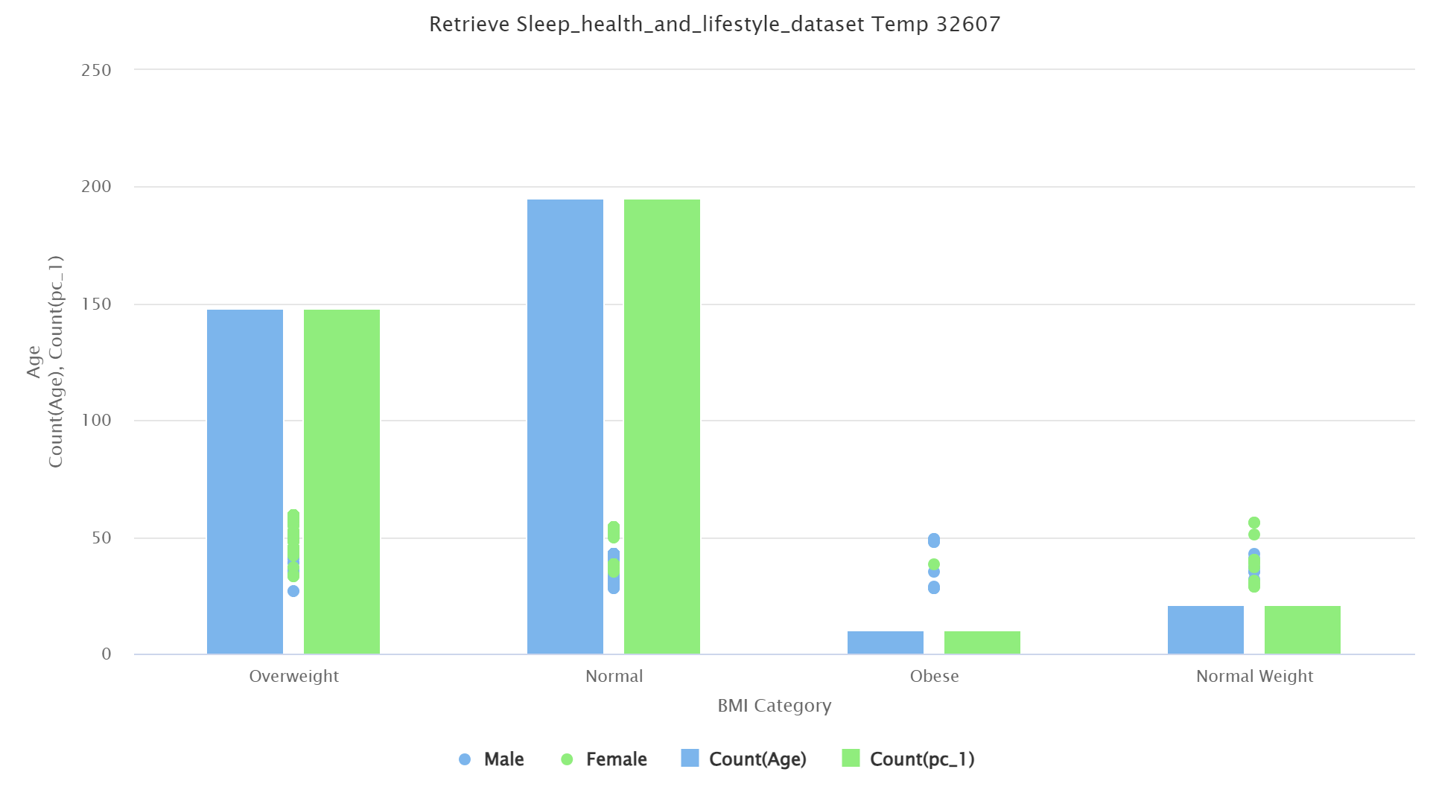
Analysis on the Dataset:
1.The bar chart shows that the highest counts of individuals are in the normal BMI category, with almost equal numbers of males and females.
2.Both males and females have similar counts in the overweight category, but there are fewer individuals in the obese and normal weight categories, with the obese category having the lowest counts.

Slide 10
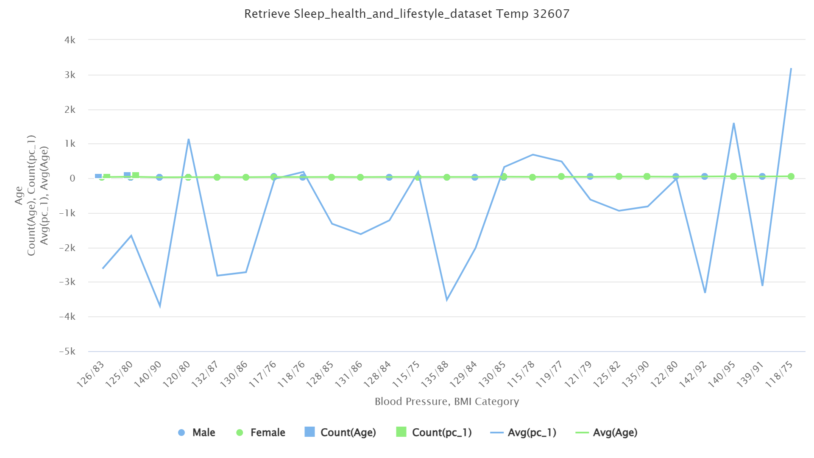
Analysis on the Dataset:
1.The line chart shows significant fluctuations in the count of age (blue line) across different blood pressure and BMI categories, indicating variability in the distribution of age within these categories.
2.The average age (green line) remains relatively stable across different blood pressure and BMI categories, suggesting that the mean age is consistent regardless of these factors.

Slide 11
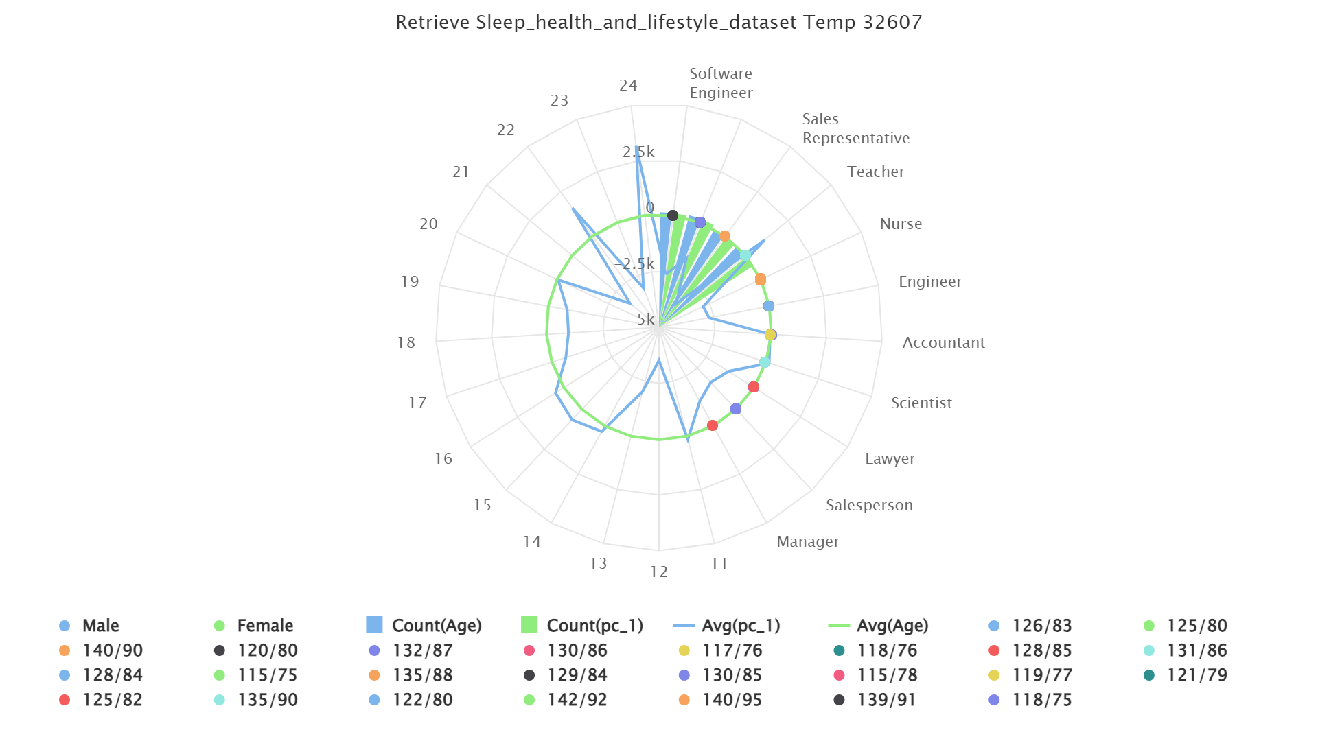
Analysis on the Dataset:
The radar chart displays various health metrics such as blood pressure (BP) for different professions, with distinct colors representing male and female averages, as well as additional metrics like age and specific counts (e.g., pc_1).
Software Engineers have a notably higher variability in their metrics compared to other professions, as indicated by the more irregular shape of their segment, suggesting greater disparities in health and lifestyle within this group.

Slide 12
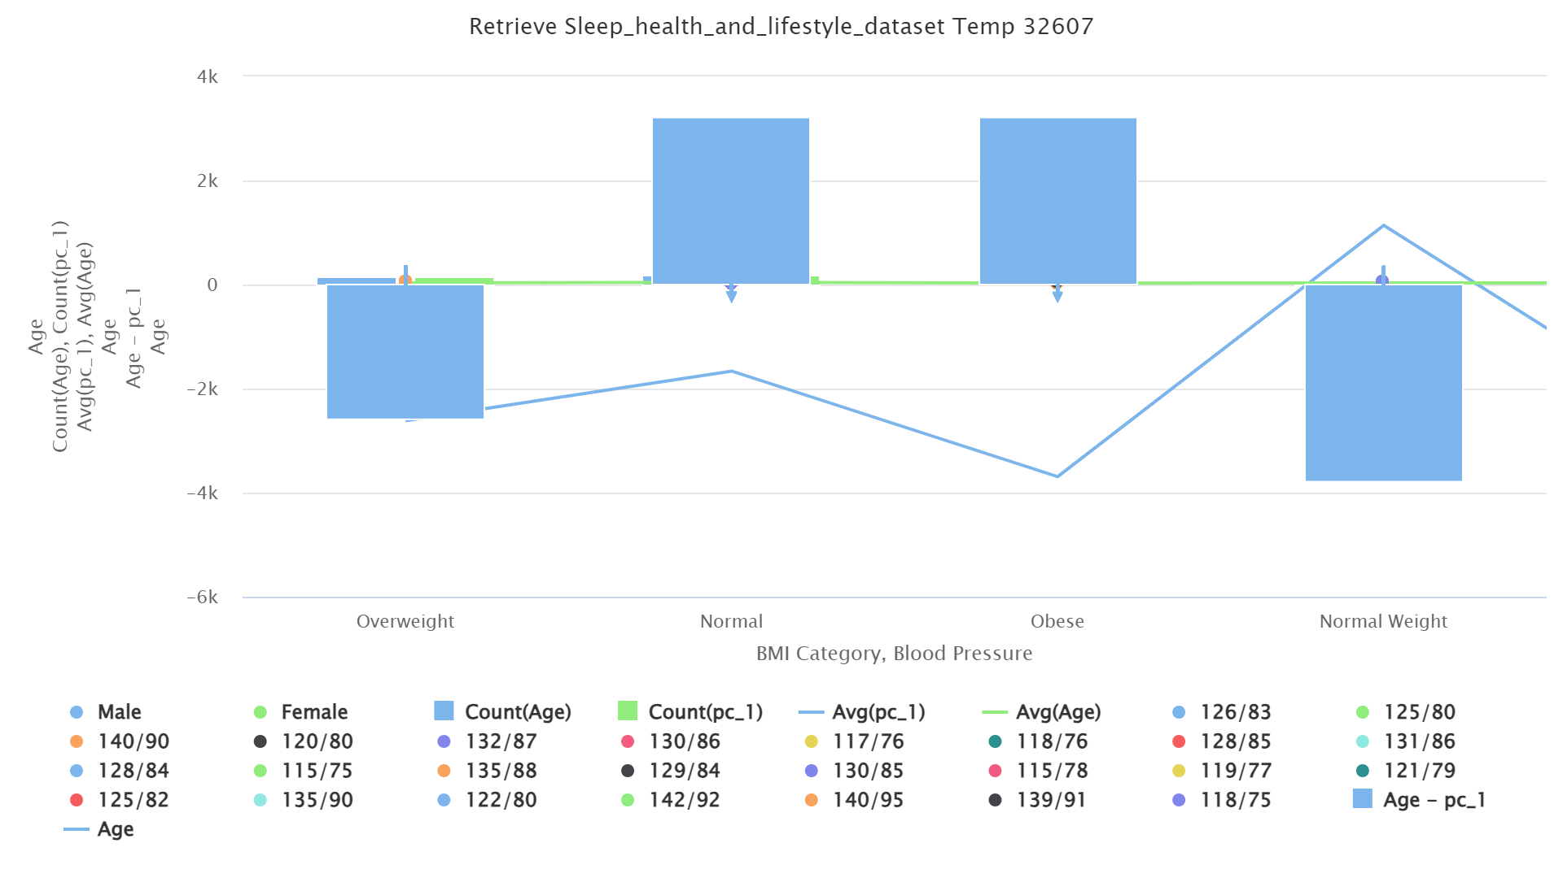
Analysis on the Dataset:
The chart indicates that there is a higher count of individuals within the "Obese" BMI category compared to other categories, as shown by the large blue bars representing count(Age).
The average age across BMI categories remains relatively stable, but the "Normal Weight" category shows a notable decrease in age difference (Age - pc_1), suggesting a younger demographic in this category compared to others.

Slide 13
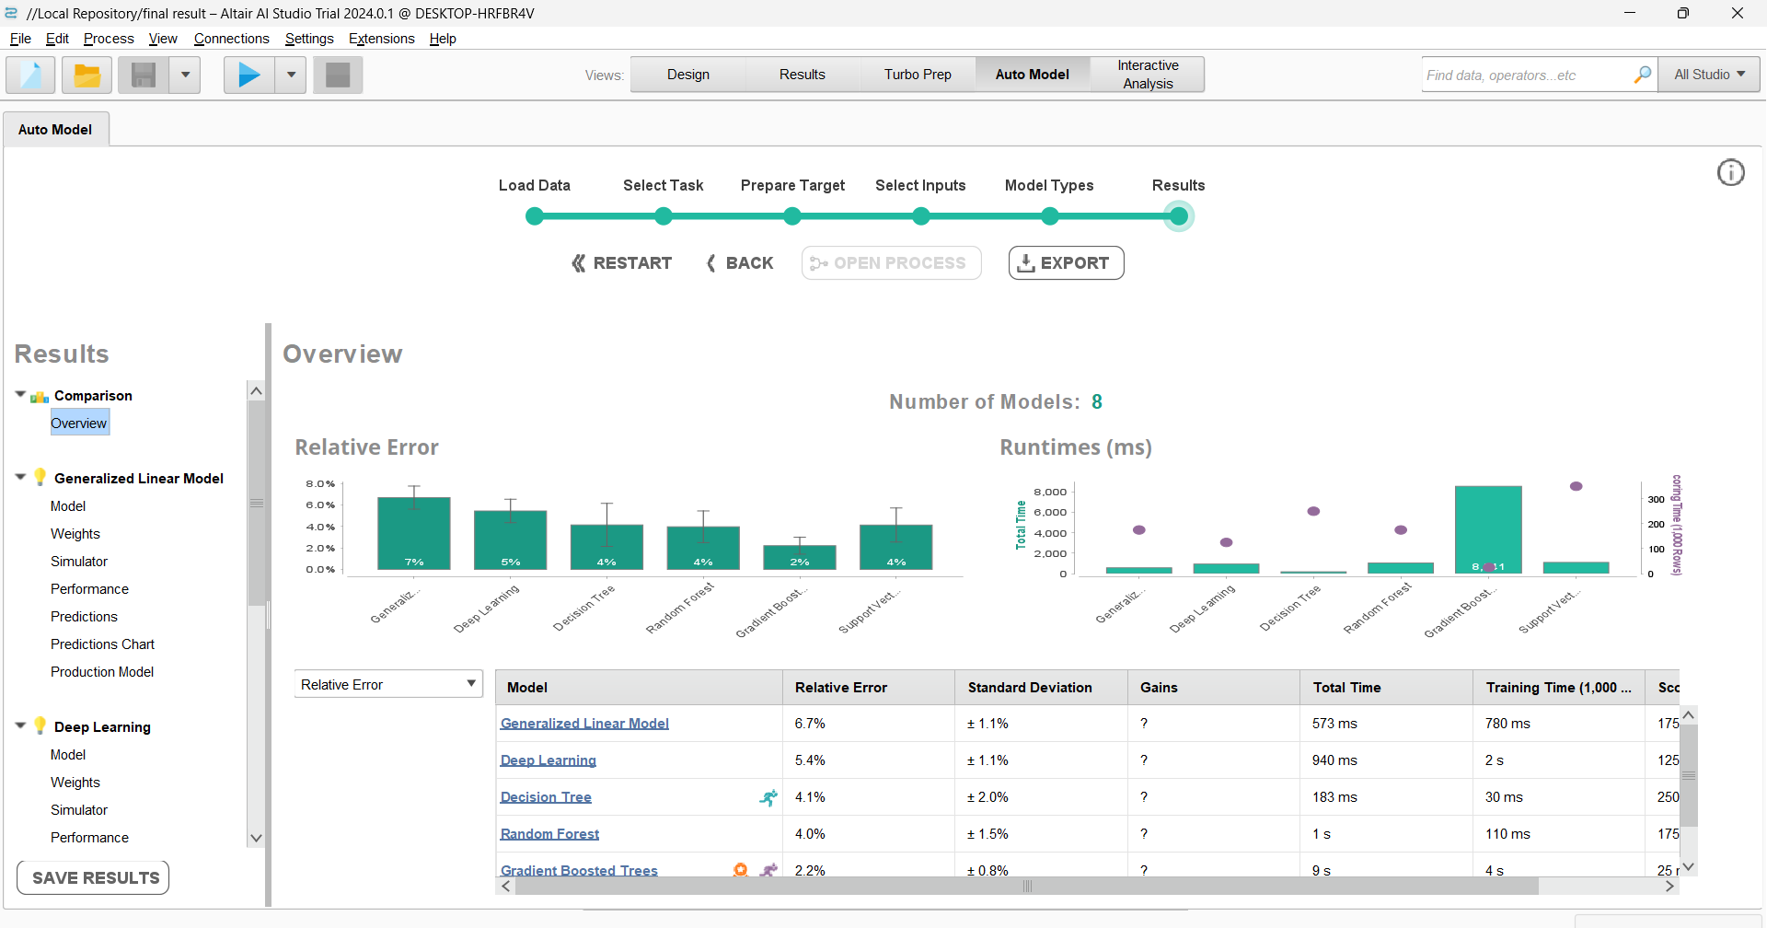
Implementation and Evaluation of Predictive Models in RapidMiner for Sleep, Health, and Lifestyle Analysis:

Slide 14
Result Analysis:
1.Gradient Boosting Exhibits Superior Performance: The Gradient Boosting model demonstrates the lowest Root Mean Squared Error (RMSE) of 2.128, indicating it provides the most precise predictions with the smallest average error among the evaluated models.
2.Deep Learning and Support Vector Machines (SVM) Perform Competitively: Both the Deep Learning and SVM models exhibit strong performance, with RMSE values of 2.284 and 2.287, respectively. While effective, they show slightly higher error rates compared to Gradient Boosting.
3.Decision Tree Model Shows the Highest Error: The Decision Tree model registers the highest RMSE of 3.454, reflecting its relative inefficacy in delivering accurate predictions compared to other models in this evaluation.

Slide 15


